Slide 1
Unveil the obscure network of company and location data using smart algorithms
Team 2: Susann, Ojasvi Prakhar, Marco, Stephanie

Slide 2
TABLE OF CONTENTS
Overview
Problem characterisation
Model & country & industry justification
Scaled accessible data sources
Method Selection
Overview of methodologies
Address normalization
Outlook
Solution
Outlook & Roadmap

Slide 3
OVERVIEW
01

Slide 4
PROBLEM CHARACTERISATION SPRINT 1
Defining features in which a company and its locations (e.g. factories, warehouses, sales points) can be interlinked.
Identifying free or paid source of information, where data supports applying an ontology to the actual companies and buildings.
Select methodologies for the implementation

Slide 5
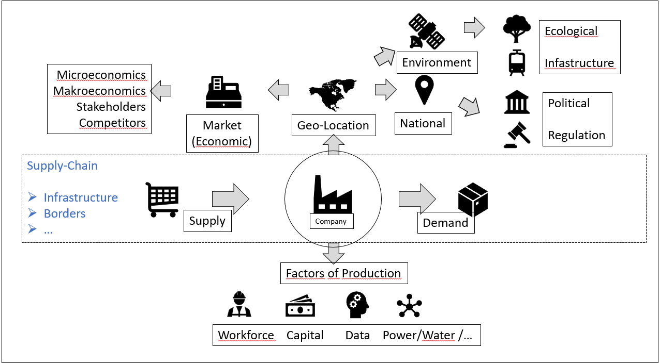
Model to explain main factors for a company related to a location
Main factors of a company
Supply Chain
Factors for production
Geo-Location Specifics
SUSANN at picture
Model is self made based on PESTEL, Porter 5, Fourastie and St. Gallen Mgmt Modell

Slide 6
Example of clustering according to factors
Cluster | Need | Explanation | Data Source
Factor of Production | Work force Power supply Water access | Educational level Age of population Reliability of Power brid Access to water | CIA factbook Global Energy Network Institute
Supply Chain | Access to transportation | Roads, Railway, Seaport, Airports | Google Maps, Satellite images, Data of shipping companies
Political / Regulation | Political set up and local regulations | Political stability, government form, corruption | CIA factbook, Transparency International Index
Economic | Economic Growth Rates Tax | GDP Exchange rate, Interest rate Inflation rate, Unemployment rate, average salaries, industrial automation Corporation tax, Capital gain tax | CIA factbook Dun Bradstreet, CIA factbook, Worldbank, statista WTO
The evaluation of data is partially provided by the data source selected and depending on sector, not in scope
FOCUS on SPRINT 1: Applied methods refer to location data

Slide 7
SELECTION OF COMPANY / COUNTRY
At least 2 way footprints inside model fourastie
Worldwide availability and several locations
Listed at stock exchange to have accessible data
Company ensures challenges with the name (e.g. through M&A transactions)
Industry selected ensures images for satellites can be differentiated
Focus on sustainability (“Green cement industry) and have Importance for the infrastructure of a country
The biggest supplier worldwide
Cement industry: 1st producer is China, 2nd India
Exclusion of China for sample set due to availability of data
Sample: LaFarge Holcim
M&A 2014 Swiss company, brand in India Ambuja Cement Limited
Primary Sector: Mining of gravel and cement
Secondary Sector: Production of concrete
Countries: Switzerland, Colombia, India
SWISSRe Team please advise

Slide 8
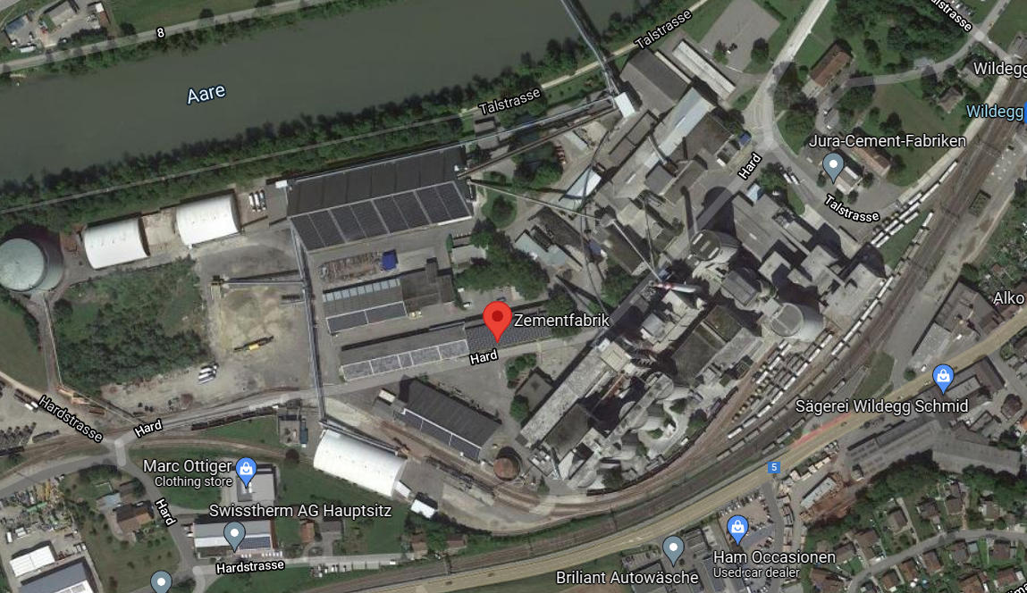
CEMENT INDUSTRY: Bird’s Eye View
Gravel site and industrial chimney, each with high confidence detected on satellite photo and terrain views. In combination and close to an urban or industrial area, railway and / or main street access, water source nearby, as well as several warehouses, silo and outdoor conveyor belts, very likely pointing to a cement factory.
Gravel terrain, 90%
Industrial Chimney, 94%

Slide 9
SCALED & ACCESSIBLE DATA SOURCES
Company information: Dun & Bradstreet, Importyeti.com, Company websites, Chambers of commerce
(Unique DUNS number in paid version of DnB allows overcoming same naming)
Blacklisted companies: Trustpilot.com, ...
Relationship and hierarchies of companies: DnB
Satellite image view: WorldView3/4-Satellite (20+ spectra), Google Maps, Yelp, NASA World Wind (LandSat 7)
Satellite terrain view: Google Earth Engine, EoFactory AI
Ground view: Google Street View

Slide 10
METHODS
02

Slide 11
METHODS
Searchable Ontology
Analysis from top view
Analysis ground view
An ontology built with a scraper that Swiss Re can use for searching for a particular company within the database.
Applying cutting-edge object detection methods to satellite, drone, airplane map APIs
Combining Natural Language Processing (NLP) text extraction with Computer Vision (CV) methods to Streetview or
Geological data

Slide 12
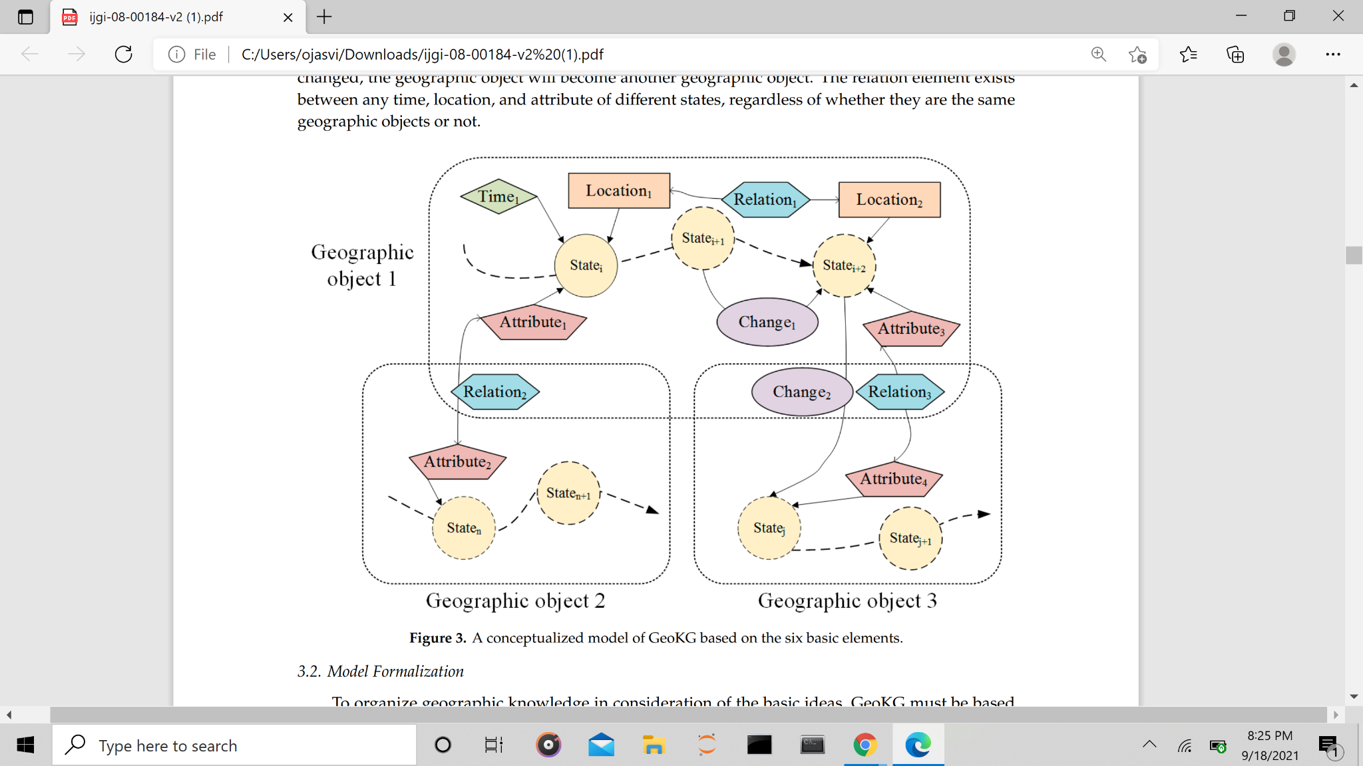
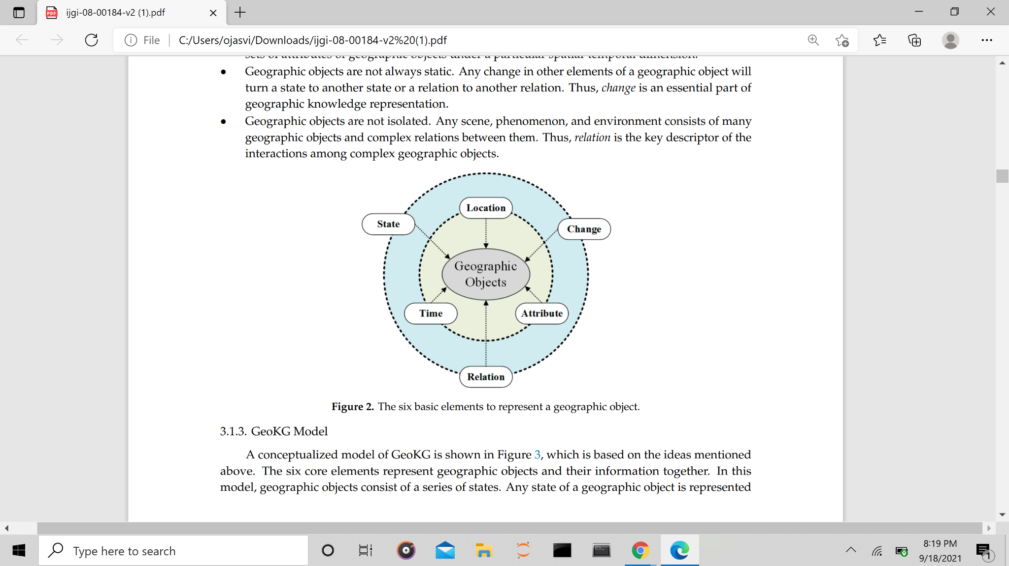
Visual representation of Ontology via Geographical Knowledge Graph (GeoKG)
Using the concept of Spatial relations and sameness among different geographical objects, we build a model that studies the relationship between the existing and possible components of the landscape as well as the situation.
[1], [2]
(a)
(b)
a) Six elements that represent a GeoKG Object
b) The interplay between multiple GeoKG objects

Slide 13
Searchable Ontology: Analysis
The business address information can be extracted from the Dun&Bradstreet with manufacturers, subsidiaries etc., or also from ImportYeti website with a web scraper or can merge it with a Selenium script. Then can plot these locations on a map or a heat-map to visualise the locations or the supply.
Strength
Easily Searchable and less coding required
NLP methods allow for hierarchy and relationships retrieval
Can be hosted on the cloud with differential access
Faster searching because the data is already loaded
Highly scaled, works globally
Weakness
Maintaining a database can be a bit less user-friendly
Companies with the same name or lots of name changes
Can take up a lot of space to store over a period of time

Slide 14
Analysis from Top View
With object identification algorithms, such as recent YOLT or YOLO versions, CNN and transformer-based solutions applied to satellite images or drone photographs in various spectra we can also provide locations of factories or tech parks that have a fence or wall around, and through this multiple buildings or offices of a company inside it. Similarly, for other domains, such as mining, power networks or factories using transfer learning applied to foundational models, or self-learning.
Strength
Allows finding buildings and objects not registered or covered in any database
Doesn’t take up a lot of space since it doesn’t store data, unless specifically desired
Updated daily, works globally
Provides further visual and more spectral data for other risk analyses too
Weakness
Takes more time to build and more code or scripts
Can be slower because API or inference may run each time
Limited to buildings and objects or industries that can be uniquely identified or attributed

Slide 15
Analysis Ground View
Can perform CV on Google Earth/Street View together with NLP cross-modally via models we have built using for instance the Sagemaker APIs to extract company names from the building names or entrance inscriptions to match and complete the list of buildings that may be away from others or detached.
Strength
Our modern computer vision text extraction methods are very precise
More extensive and accurate than from satellite view
Very detailed, allowing for further risk factor analyses
Works for almost all industrial areas
Weakness
Limited to where street image data or other image data is available
Less frequently updated
Not showing company relationships

Slide 16
Address Text Normalisation
(Secondary Problem)
For the secondary problem of normalising address names, we can use fuzzy logic for address matching with the Levenshtein as distance metric for a probability score for how close they match, and similar address matching methods, such as the SwissRe database and new web APIs. The accuracy can also be enhanced further via modern NLP or bi-modal pattern matching methods.
This can be combined with the Google Maps or Bing APIs to find the corresponding location and coordinates. The coordinates can then be stored in a database or ontology. This process can be made as a real-time service using Python scripts.

Slide 17
OUTLOOK
03

Slide 18
Our Solution
NLP Ontology
Computer Vision Extension
Very complete, global
Fast, readily available
Not expensive
Automatic update alerts
Fraud prevention
Better risk assessment
Can complement the missing entries globally
Images updated daily
Independent analysis for further fraud prevention
Unmatched risk assessment

Slide 19
2 Solutions
Text Extraction of company names from the buildings or building entrances signs, potentially for inclined sat view.
Inc./Excl.
Assumptions:
2.) Semantic image search using CLIP (from OpenAI) applied to mainly StreetView, but can be extended globally via sat view.
Inclination not required

Slide 20
Outlook for SPRINT 2
Our goals for sprint 2 are:
Collect company information from platforms like ImportYeti and DnB using scraping tools
Implement the Vision API to extract company names from Google Street View and Google Earth and other sources
Build a searchable ontology for Swiss Re to abstract the API calls and matching processes in the background
Perform text normalization exercise to match the company address to a single address irrespective of spelling.
Please check the Notebooks and the attached word template where we list further solutions and information sources

Slide 21
Roadmap
DAY 1
Sprint 2
Sprint 1
20th of September
17th of October
Ideation, built out the Use case, prototyping
Submission & Presentation
Kick Off, Get to Know, Independent Search
Built out the implementation, scaling, demo creation

Slide 22
THANKS!
Do you have any questions?
Team 2

Slide 23
BackUp

Slide 24
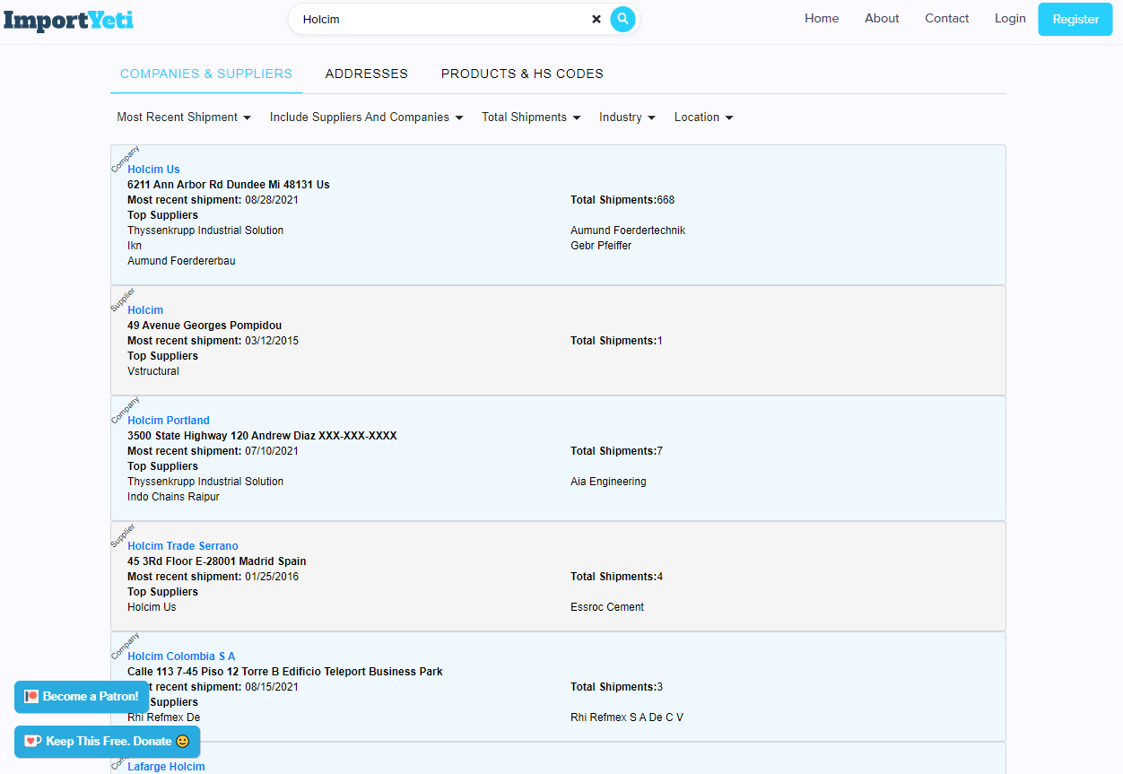

Slide 25
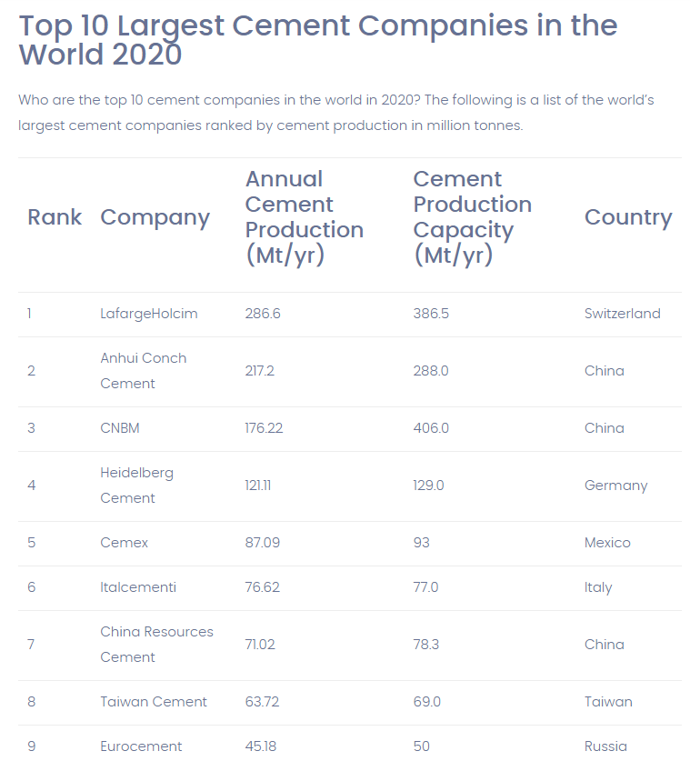
Overview Cement Industry

Slide 26
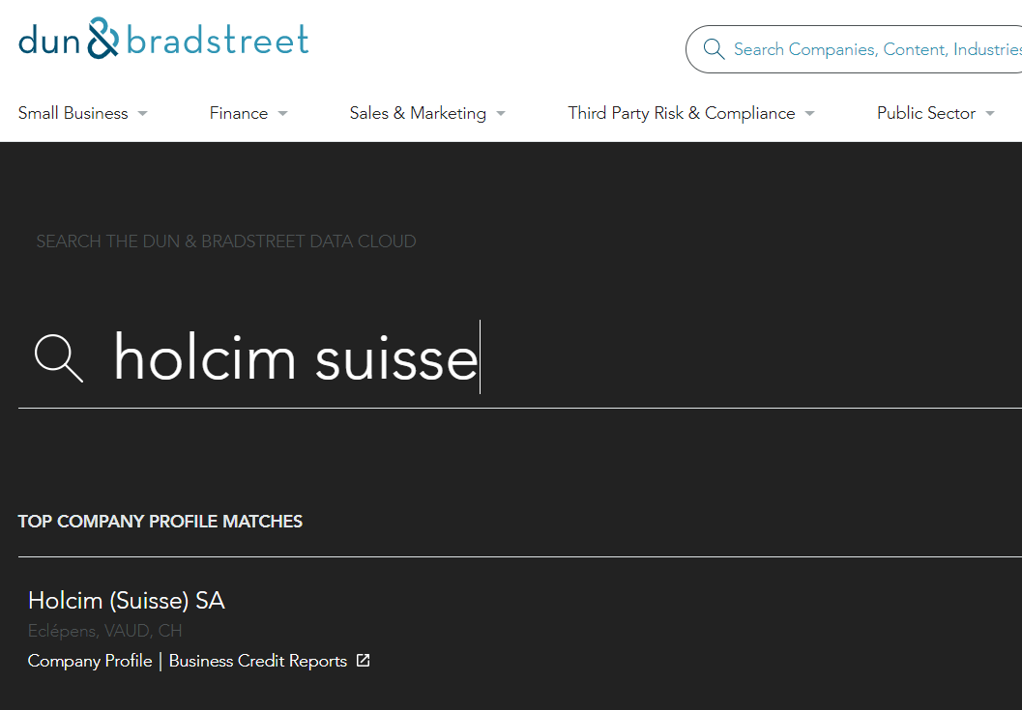
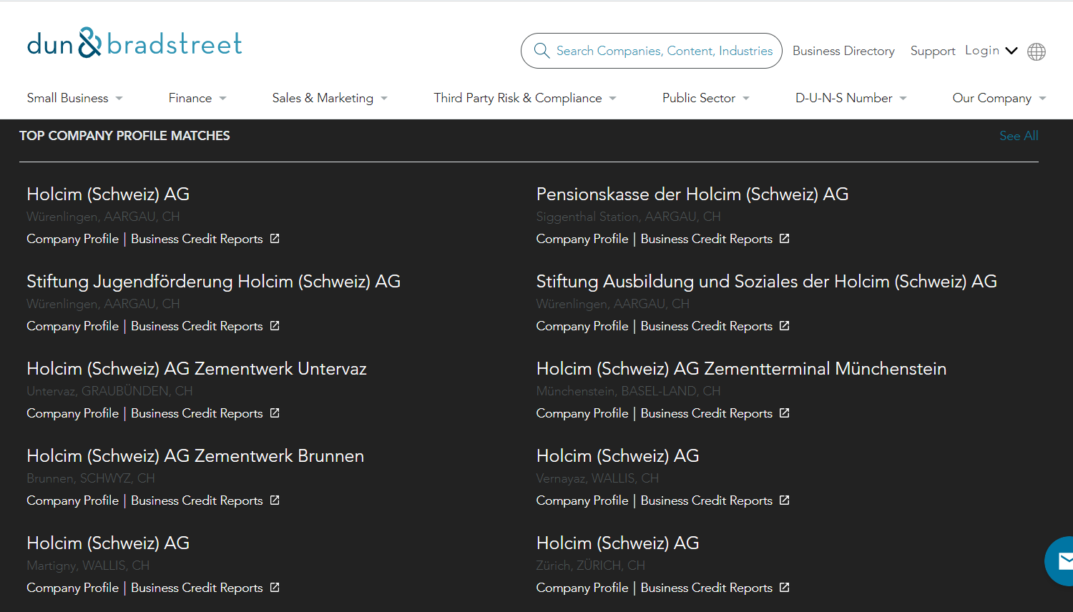
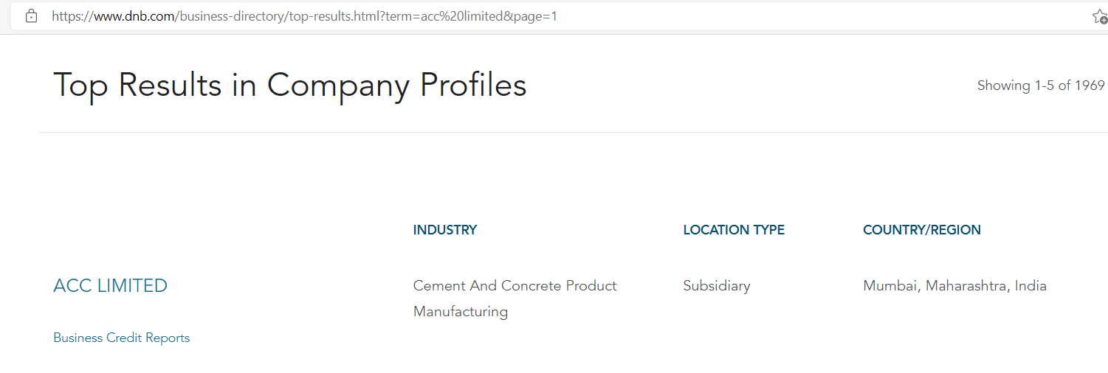
Ideas of companies LafargeHolcim
Test Duns & Bradstreet website - three cement manufacturer in Switzerland and ACC limited in India available
Google Maps: Search with name Holcim Schweiz AG only 2 hints,

Slide 27
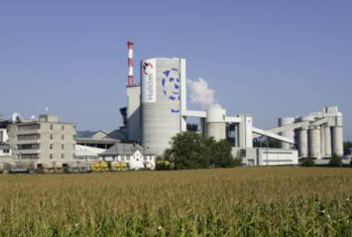
Lafarge Holcim

Slide 28
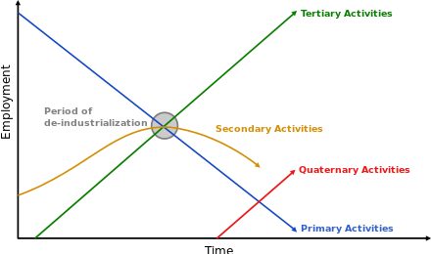
THREE SECTOR MODEL FOURASTIE TO WEIGHT RELEVANT FACTORS OF PESTL
Primary: involves the retrieval and production of raw materials, such as corn, coal, wood or iron.
Secondary: involves transformation of raw or intermediate materials into goods, as in steel into cars, or textile into clothes.
Tertiary: involves the supplying of services to consumers and businesses, such as babysitting, cinemas or banking.
“Quaternary" and “quinary” service sectors: economic activity in the hypothetical quaternary sector comprises knowledge- and info-based services, while quinary services include industries related to human services and hospitality.
Company of interest has impact on Primary & Secondary Sector
Economic sector - Wikiwand

Slide 29
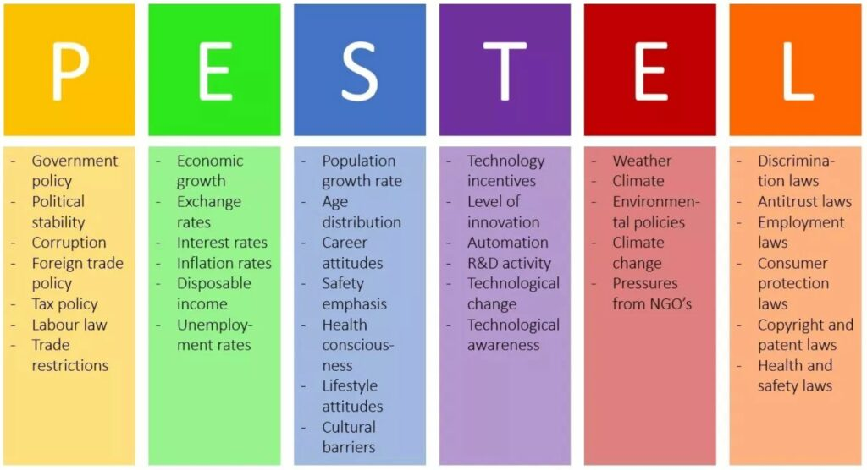
Influencing factor for a company to evaluate risks
PESTEL- Political, Economic, Socio-cultural, Technological, Environmental geographic and Legal.
PESTEL Analysis (PEST Analysis) EXPLAINED with EXAMPLES | B2U (business-to-you.com)

Slide 30
Data sources for referring links
Database / Source | Type of Information
Google maps or Google Street View, google earth | Computer vision on satellite imagery or Street view extraction
maps.me, yelp, bing | Computer vision on satellite imagery or Street view extraction
Duns and Beadstreet dnb.com | comprehensive business data and analytical insights to power today’s most crucial business needs.
Companies website holcim.com | Subsidiary and parent company information, address code annual/ quarterly reports
chamber of commerce moneyhouse zefix.com | information official listed companies example Switzerland
placekey.io/blog/adress-matching | Ideas on way how to solve it
importyeti.com | supplier and companies/manufacturer information
The World Factbook Archives - The World Factbook (cia.gov) | Information on countries Switzerland - The World Factbook (cia.gov) Colombia - The World Factbook (cia.gov), India - The World Factbook (cia.gov)
Indian Cement Industry Analysis | IBEF | Indian Cement Industry Analysis | IBEF
Top 10 Cement Companies in the World 2020 | Global Cement Industry (bizvibe.com) | Top 10 Cement Industry worldwide
Global Energy Network Institute | National Energy Grid - Index - Global Energy Network Institute - GENI is the highest priority objective of the World Game (R. Buckminster Fuller).

Slide 31
OVERVIEW
PROBLEM CHARACTERISATION
COUNTRY & INDUSTRY
Linking companies to location data
Switzerland, India, Colombia
&
Cement Industry:
LaFarge Holcim

